Slide 1

EDA – Credit Card Analysis
- Prachi Gorwadkar

Slide 2
Business Understanding & Overview
The loan providing companies find it hard to give loans to the people due to their insufficient or non-existent credit history. Because of that, some consumers use it to their advantage by becoming a defaulter. Suppose you work for a consumer finance company which specialises in lending various types of loans to urban customers. You have to use EDA to analyse the patterns present in the data. This will ensure that the applicants capable of repaying the loan are not rejected.
So, we will perform Exploratory Data Analysis (EDA) in order to get insights, analyze the data, summarize the characteristics of the data and present it to the companies so that they can take necessary actions in order to reject or accept loan applications.

Slide 3
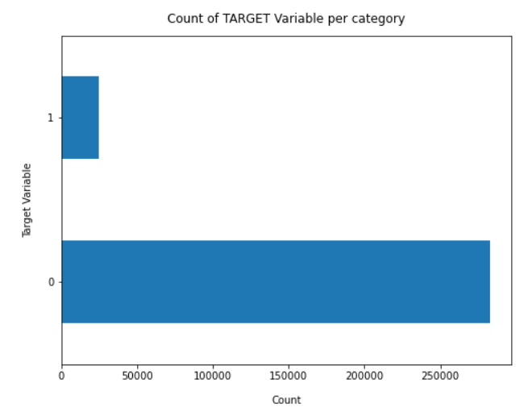
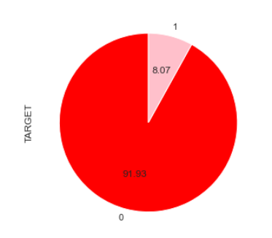
Target Variable Findings
Data is highly imbalanced, ratio is
almost 92%:8%.
Most of the loans are paid back
on time.
Now we need to analyse other data
with target values.

Slide 4
Misssing Data - Findings
For features with less missing values- can use regression to predict the missing values or fill with the mean of the values present, depending on the feature.
For features with very high number of missing values- it is better to drop those columns as they give very less insight on analysis.
As there's no thumb rule on what criteria do we delete the columns with high number of missing values, but generally you can delete the columns, if you have more than 30-40% of missing values.
Decision has to be taken wisely, by doing types of analysis. Done on nest slides…

Slide 5
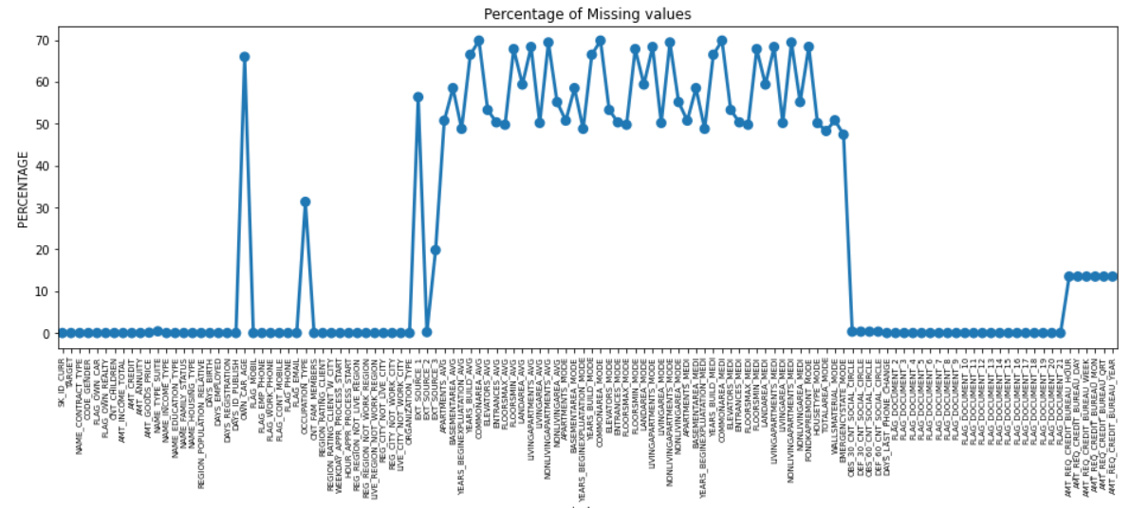
Findings
Total columns having more than 30% of null values. As there is no thumb rule for deleting NULL values, but we can decide it on the % of NULL values as well as their importance of data within. Most of the columns are Normalization information, so will delete Normalized information columns.
In the later stage, we can analyze the deleted columns if they carry any important information or not.

Slide 6
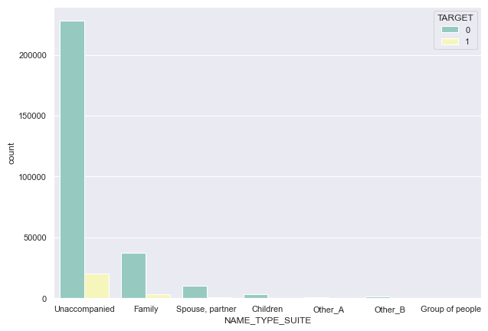
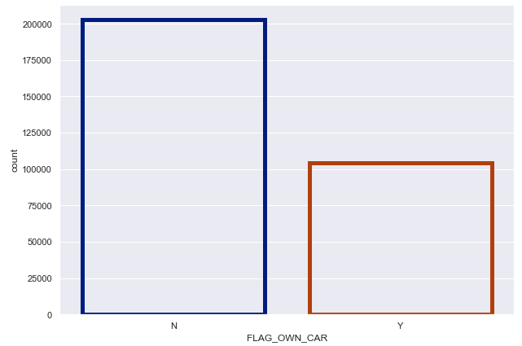
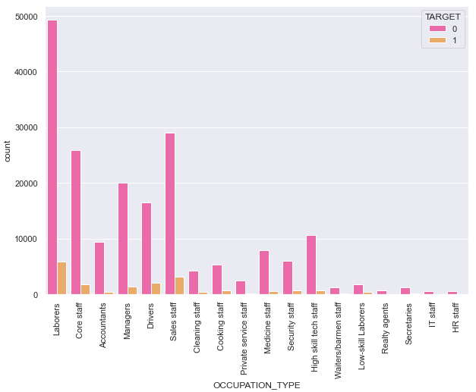
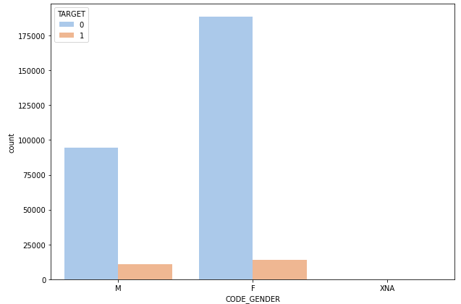
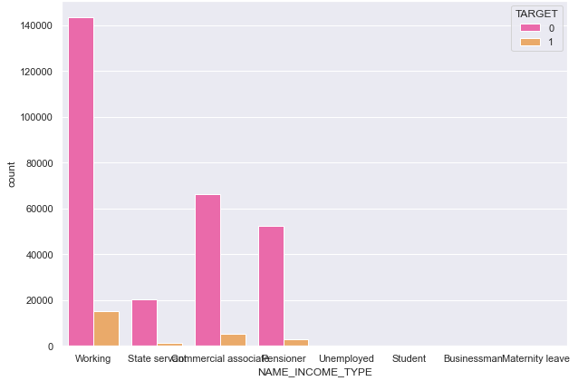
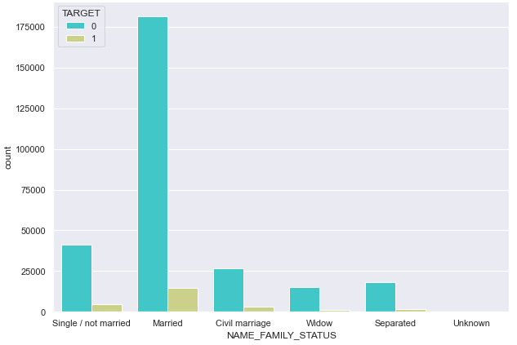
Univariate Analysis
Findings
By just analyzing a single variable we won't find much insights related to defaulters. Here we get idea about which category people are in abundance. And here most of the insights are gathered in analysis of multiple variables with respect to the target variable.

Slide 7
Categorical analysis

Slide 8
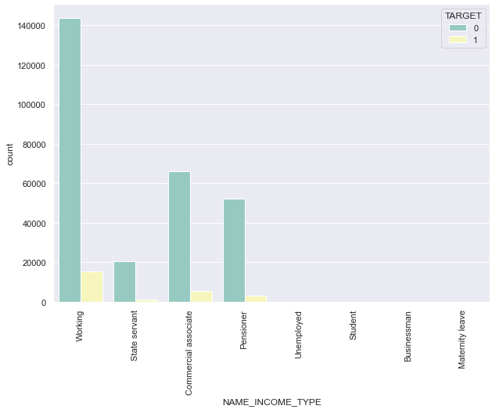
Findings
The working class applies the most for the loans and a very low default rate.
Commercial Associates, Pensioners and state servants are fairly more reliable.
Clients who are State servants, unemployed and on Maternity leave and students are very high defaulters.

Slide 9
Findings
Married status clients have very low default rates.
Single/not married, civil marriage, separated and widow status clients are mostly defaulters.
This gives a good insight.

Slide 10
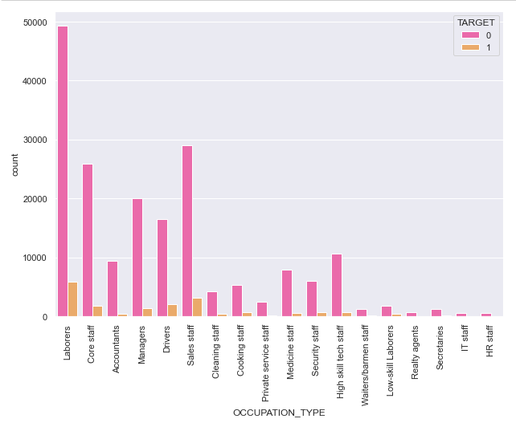
Findings
Laborers, Core Staff, Managers, Sales staff are mostly reliable with very low default rates.
Reality agents clients are mostly defaulters.
But this finding does not give much insight.

Slide 11
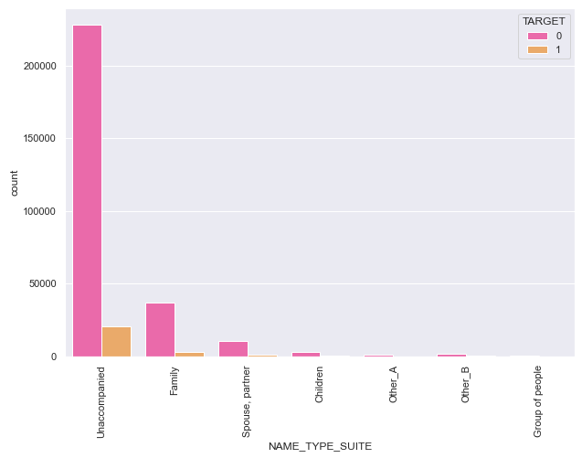
Findings
Unaccompanied clients are mostly reliable with very low default rates.
Clients with family and others are mostly defaulters.

Slide 12
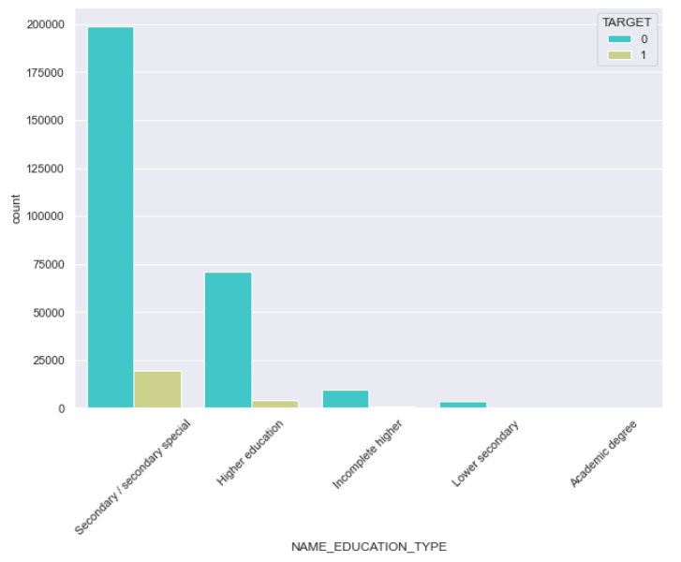
Findings
Clients having Secondary education and Higher education are mostly reliable with very low default rates.
Clients who have incomplete higher education or lower secondary degree, are defaulters.

Slide 13
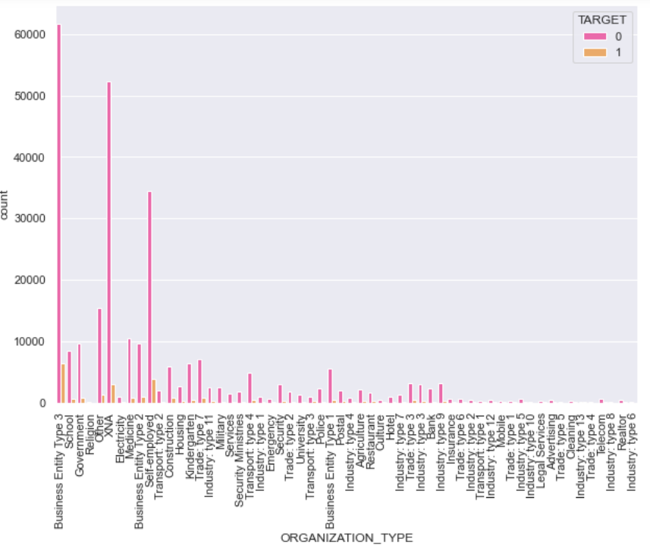
Findings
Organizations with Business Entity Type 3
Clients who have incomplete higher education or lower secondary degree, are defaulters.

Slide 14
numerical analysis

Slide 15
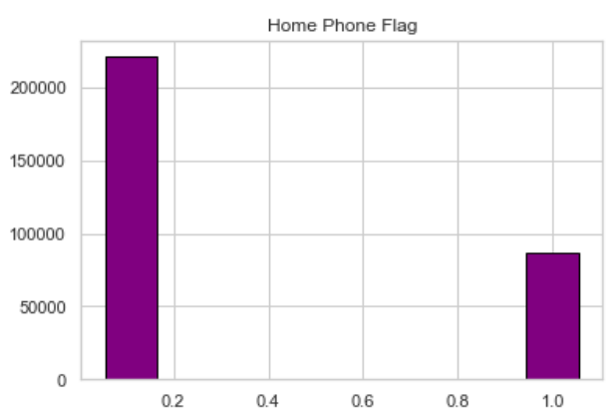
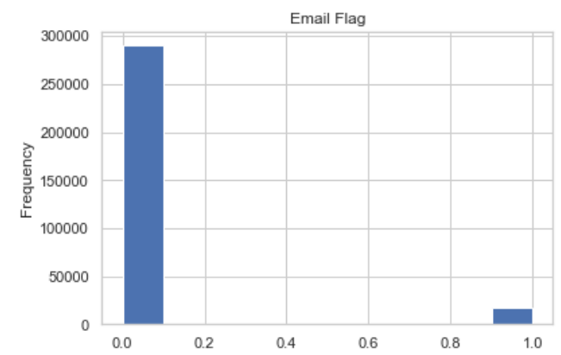
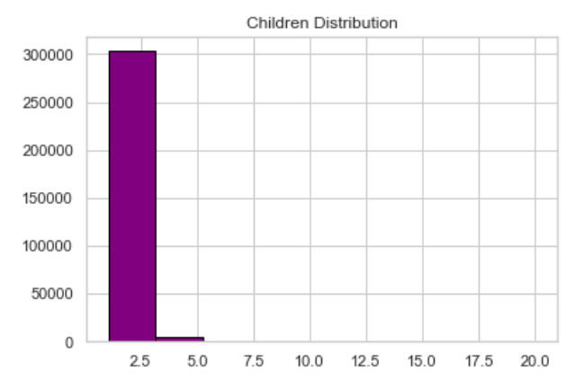
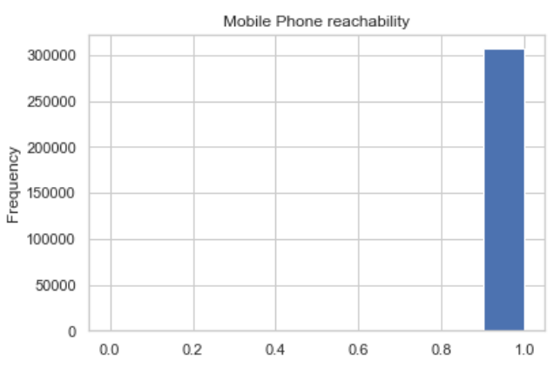
Univatiate Analysis- Numerical
Most of the clients phone was reachable.
Most of the Clients provided email address.
Most of the clients have provided home phone number.

Slide 16
bivariate analysis

Slide 17
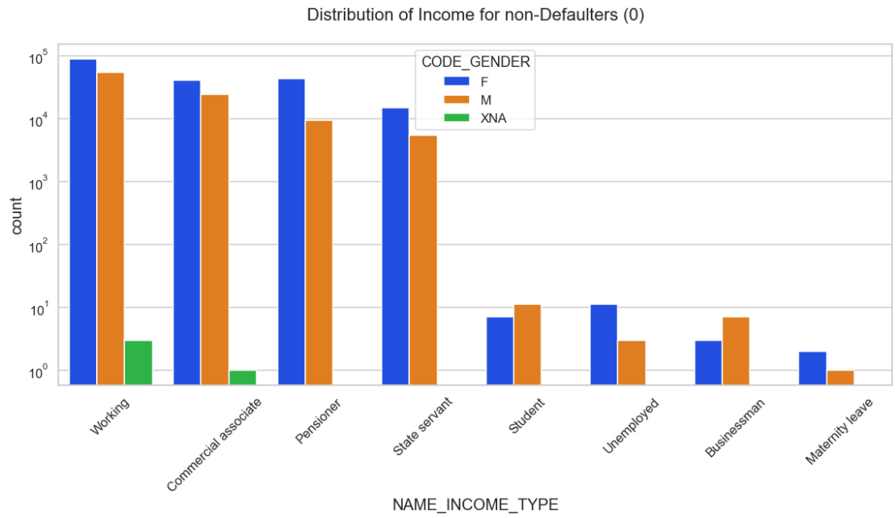
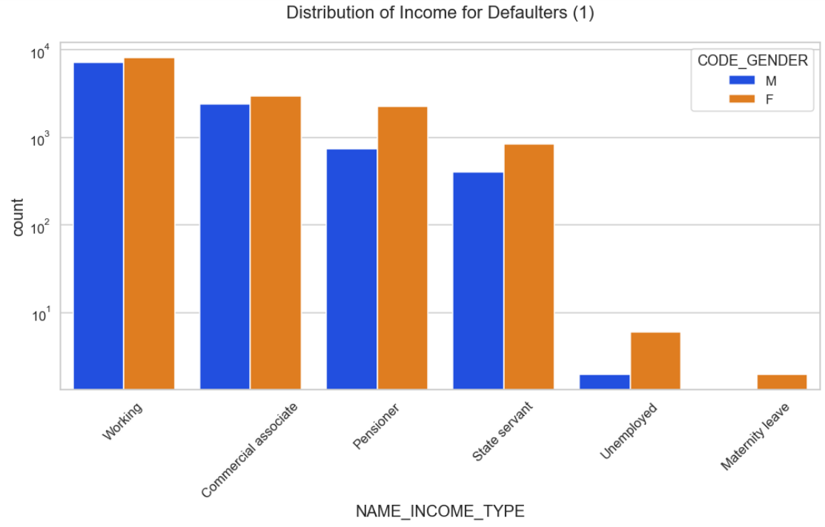
Few good Insights
For Income type Working, Commercial Associates, Pensioners and State Servants, the number of credits are higher than others like Student, maternity Leave etc.
In this, females have more numbers of credit than males.
For Target value: 1, there is no Income type for Students, Businessman, which means they don’t do late payments.
This states that, females have marginally higher default rate as compared to males and most defaulters are working professionals, commercial associates, Pensioners and state servants. Students, businessman are not late payers.

Slide 18
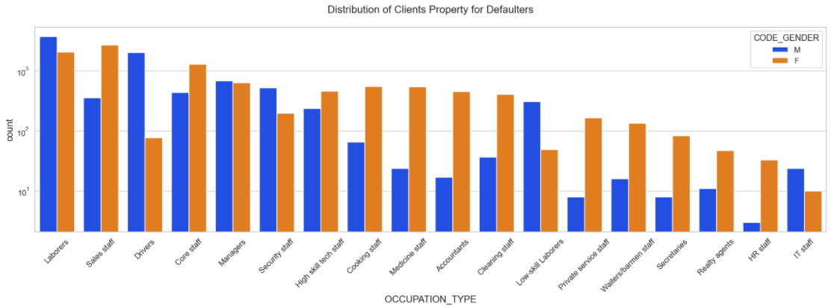
Few good Insights
Males under occupation : Low skilled laborers, Drivers etc. are the most defaulted subcategories against their female counterparts.
Females under occupation: Accountants, Private service staff, Medicine staff, Realty Agents, HR Staff, Secretaries etc. are the most defaulted sub categories against their male counterparts.

Slide 19
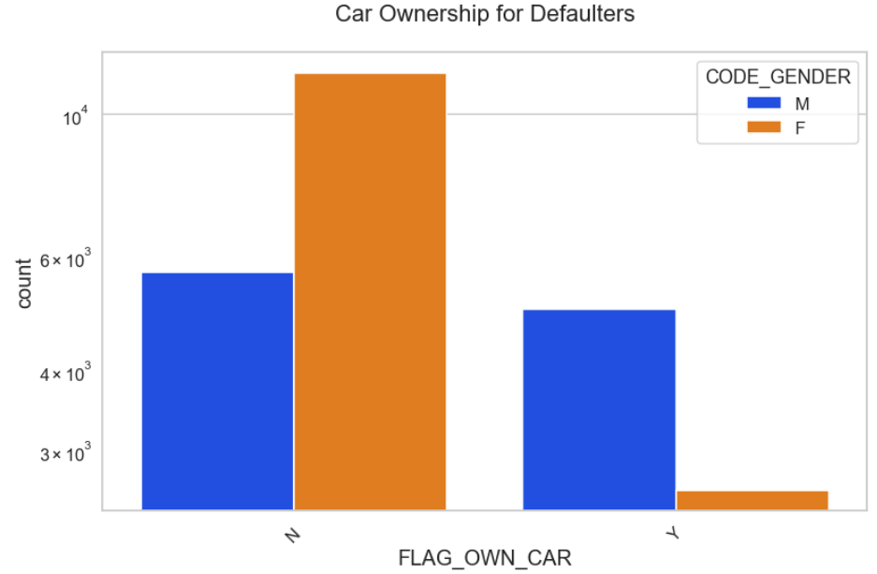
Few good Insights
Overall people without cars are most defaulters, in which we can find that female without cars are most defaulters than the males without cars.

Slide 20
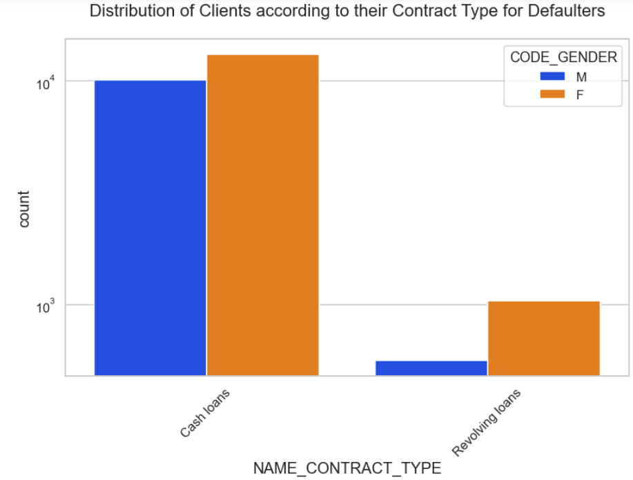
Some Good Insights
Its clear from the bar plot that both females/males having cash loans have almost equal ratio in defaulting.
But when you look at the revolving loans, even if the number is less, we can find that females who have Revolving loans are the most defaulters as compared to the males.

Slide 21
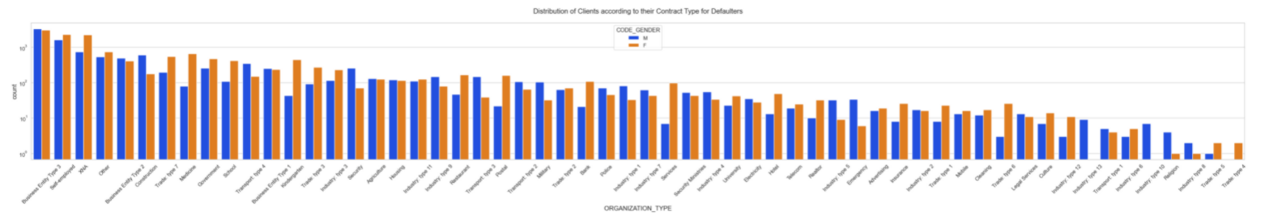
Clients which have applied for credits, are from most of the organization types Self-employed, Business Entity Type 3, Self employed, Medicine, Government & Other.

Slide 22
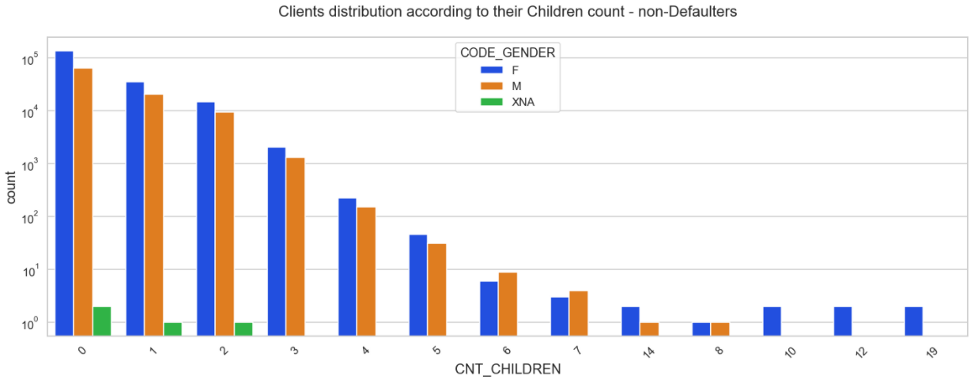
Findings
Clients having less number of children are more likely to repay, in such case both males and females are equally repaying the loans.
But if the number of children increases the defaulters rate increase.

Slide 23
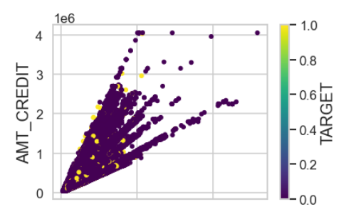
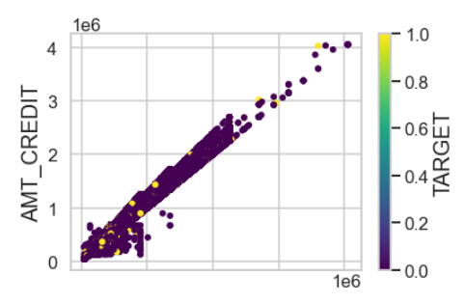
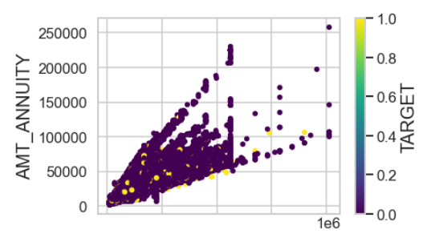
Some Good Insights
Its clear from the 1st plot that Credit Amount increases as the Annuity amount increases for both Defaulters as well as the non-Defaulters.
From 2nd , we can observe that if the Amount of Goods price is more then the Credit Amount is higher.
And from the 3rd one, we get the insight that Annuity amount increases with the Goods price for both Defaulters as well as the non-Defaulters.

Slide 24
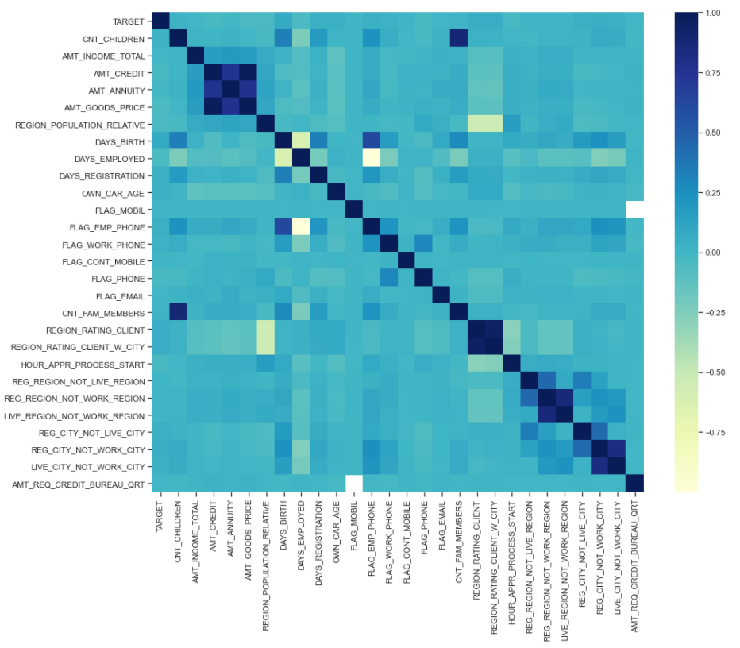
Correlation Matrix

Slide 25
Final Findings
We investigated the data, checking for data unbalancing, visualizing the features and understanding the relationship between different features.
These are some of the quick insights from this exercise:
1. Females are the highest kind of Defaulters.
2. Married Clients are the highest kind of Defaulters.
3. Secondary or secondary special educated customers are highest defaulters.
4. Clients having house/apartment are the highest defaulters.
5. Working customers are the highest Defaulters.
6. Family members of the Client and the the no of children the Client has appear highly, positively, correlated – this is shown
in the pair plot and correlation matrix outputs
7. From the heatmap, we can conclude that Goods price amount is highly correlated with the amount credited.
8. No of days the cli ent is employed is -vely correlated with the clients work-phone number

